Slide 1
Digital Image Processing
Chapter 5: Image Restoration and Reconstruction

Slide 2
A Model of the Image Degradation/Restoration Process

Slide 3
Degradation
Degradation function H
Additive noise
Spatial domain
Frequency domain

Slide 4
Restoration

Slide 5
Noise Models
Sources of noise
Image acquisition, digitization, transmission
White noise
The Fourier spectrum of noise is constant
Assuming
Noise is independent of spatial coordinates
Noise is uncorrelated with respect to the image itself

Slide 6
Gaussian noise
The PDF of a Gaussian random variable, z,
Mean:
Standard deviation:
Variance:

Slide 7
70% of its values will be in the range
95% of its values will be in the range

Slide 8
Rayleigh noise
The PDF of Rayleigh noise,
Mean:
Variance:

Slide 9
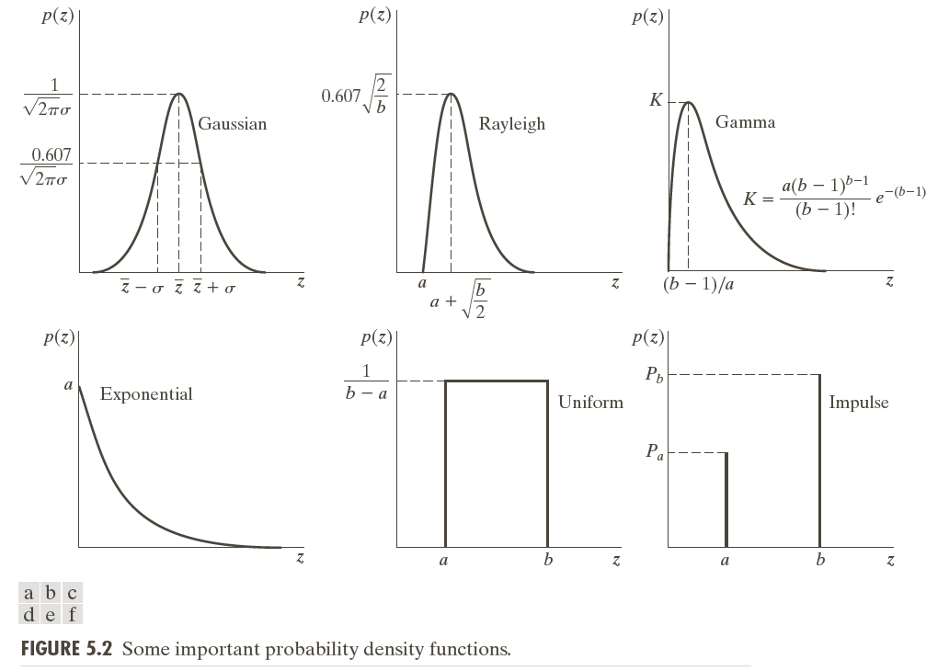

Slide 10
Erlang (Gamma) noise
The PDF of Erlang noise, , is a positive integer,
Mean:
Variance:

Slide 11
Exponential noise
The PDF of exponential noise, ,
Mean:
Variance:

Slide 12
Uniform noise
The PDF of uniform noise,
Mean:
Variance:

Slide 13
Impulse (salt-and-pepper) noise
The PDF of (bipolar) impulse noise,
: gray-level will appear as a light dot, while level will appear like a dark dot
Unipolar: either or is zero

Slide 14
Usually, for an 8-bit image, =0 (black) and =255 (white)

Slide 15
Modeling
Gaussian
Electronic circuit noise, sensor noise due to poor illumination and/or high temperature
Rayleigh
Range imaging
Exponential and gamma
Laser imaging

Slide 16
Impulse
Quick transients, such as faulty switching
Uniform
Least descriptive
Basis for numerous random number generators

Slide 20
Periodic noise
Arises typically from electrical or electromechanical interference
Reduced significantly via frequency domain filtering

Slide 21
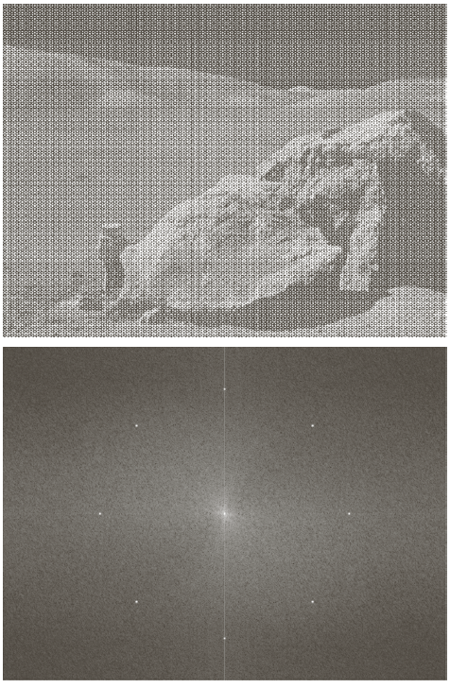
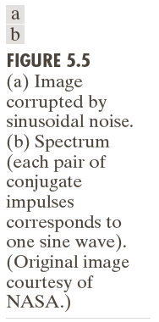

Slide 22
Estimation of noise parameters
Inspection of the Fourier spectrum
Small patches of reasonably constant gray level
For example, 150*20 vertical strips
Calculate , , , from

Slide 24
Restoration in the Presence of Noise Only-Spatial Filtering
Degradation
Spatial domain
Frequency domain

Slide 25
Mean filters
Arithmetic mean filter
Geometric mean filter

Slide 26
Harmonic mean filter
Works well for salt noise, but fails fpr pepper noise

Slide 27
Contraharmonic mean filter
: eliminates pepper noise
: eliminates salt noise

Slide 28
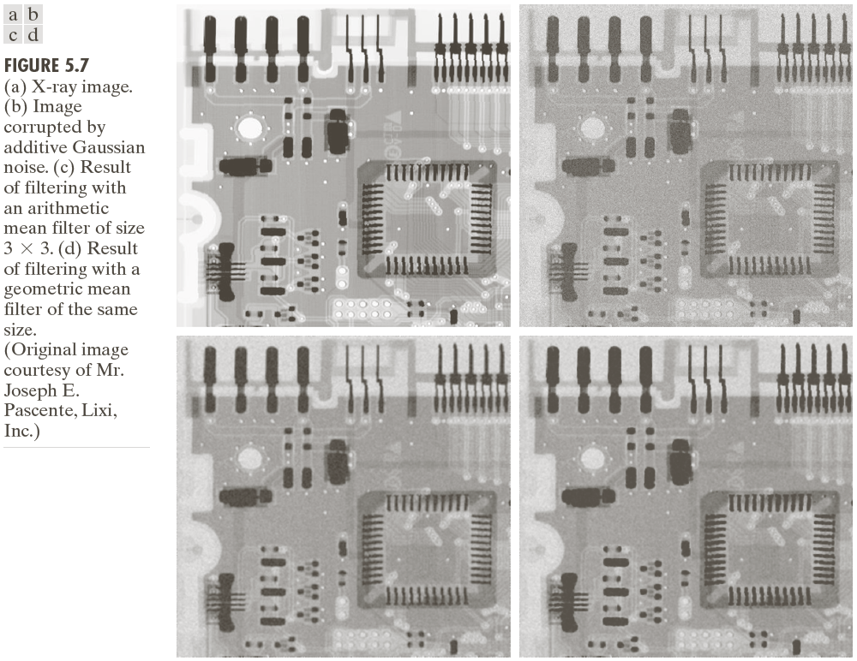

Slide 30
Usage
Arithmetic and geometric mean filters: suited for Gaussian or uniform noise
Contraharmonic filters: suited for impulse noise

Slide 32
Order-statistics filters
Median filter
Effective in the presence of both bipolar and unipolar impulse noise

Slide 33
Max and min filters
max filters reduce pepper noise
min filters salt noise

Slide 34
Midpoint filter
Works best for randomly distributed noise, like Gaussian or uniform noise

Slide 35
Alpha-trimmed mean filter
Delete the d/2 lowest and the d/2 highest gray-level values
Useful in situations involving multiple types of noise, such as a combination of salt-and-pepper and Gaussian noise

Slide 36
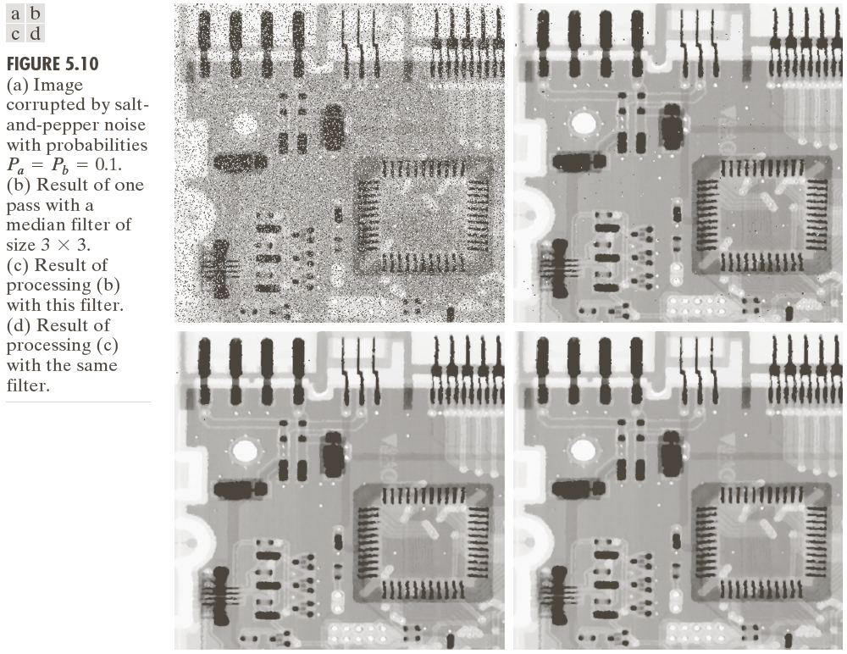

Slide 37
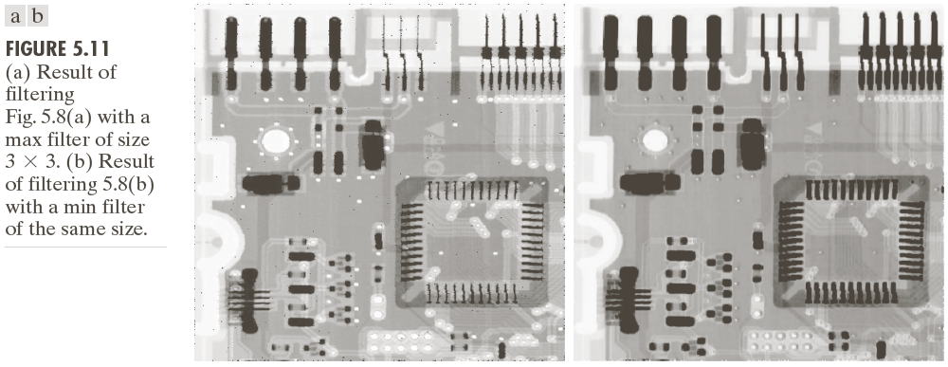

Slide 38
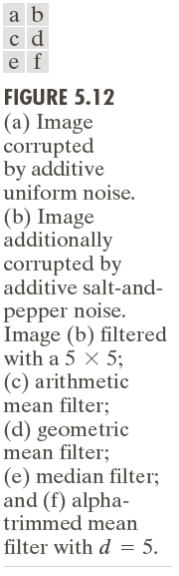

Slide 39
Adaptive, local noise reduction filter
If is zero, return simply the value of
If , return a value close to
If , return the arithmetic mean value

Slide 41
Adaptive median filter
= minimum gray level value in
= maximum gray level value in
= median of gray levels in
= gray level at coordinates
= maximum allowed size of

Slide 42
Algorithm:
Level A: A1=
A2=
If A1>0 AND A2<0, Go to
level B
Else increase the window size
If window size
repeat level A
Else output

Slide 43
Level B: B1=
B2=
If B1>0 AND B2<0, output
Else output

Slide 44
Purposes of the algorithm
Remove salt-and-pepper (impulse) noise
Provide smoothing
Reduce distortion, such as excessive thinning or thickening of object boundaries

Slide 46
Periodic Noise Reduction by Frequency Domain Filtering
Bandreject filters
Ideal bandreject filter

Slide 47
Butterworth bandreject filter of order n
Gaussian bandreject filter

Slide 50
Bandpass filters

Slide 51
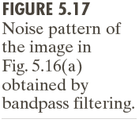

Slide 52
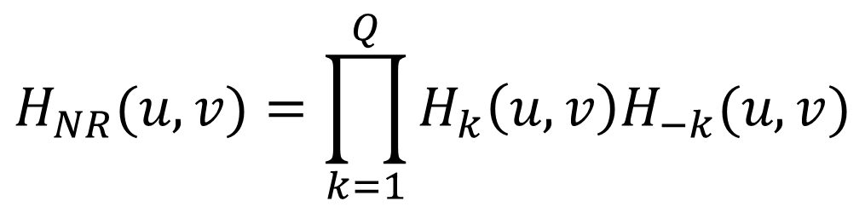
Notch filters

Slide 53
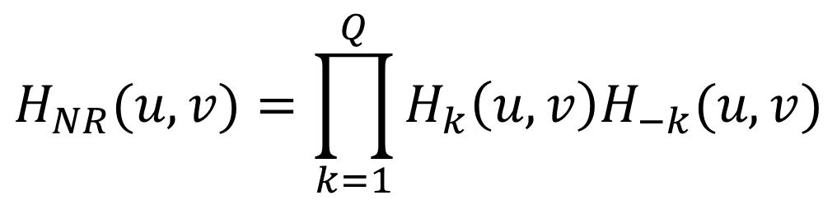
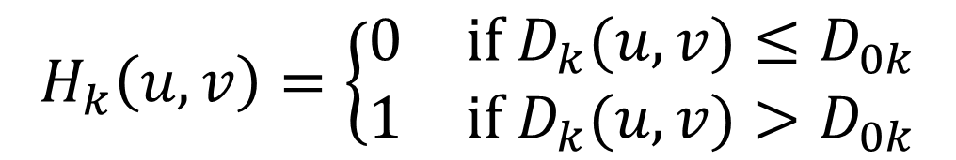
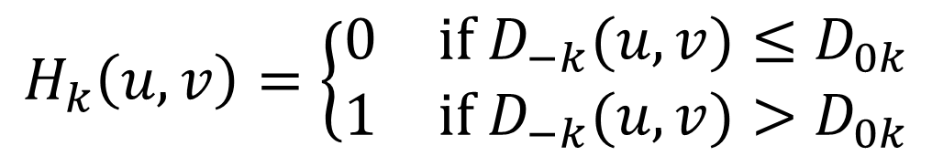
Notch filters
Ideal notch reject filter

Slide 54
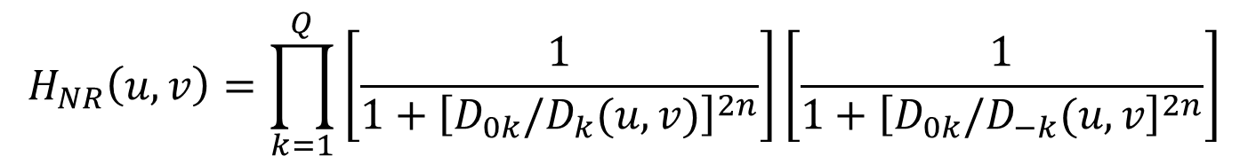
Butterworth notch reject filter of order n
$$H_{NR}\left(u,v\right)=\prod_{k=1}^{Q}{\left[\frac{1}{1+{\left[D_{0k}/D_{k}(u,v)\right]}^{2n}}\right]\left[\frac{1}{1+{\left[D_{0k}/D_{−k}(u,v\right]}^{2n}}\right]}$$

Slide 55
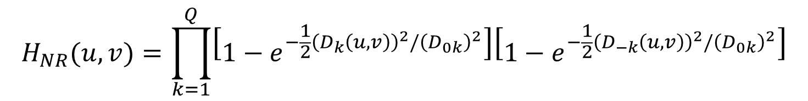
Gaussian notch reject filter

Slide 57
Notch pass filter

Slide 59
Optimum notch filtering

Slide 60
Interference noise pattern
Interference noise pattern in the spatial domain
Subtract from a weighted portion of to obtain an estimate of

Slide 61
Minimize the local variance of
The detailed steps are listed in Page 341
Result

Slide 64
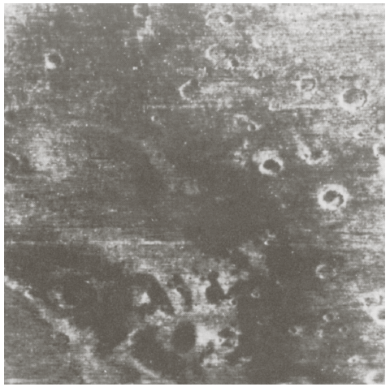

Slide 65
Linear, Position-Invariant Degradations
Input-output relationship

Slide 66
H is linear if
Additivity

Slide 67
Homogeneity
Position (or space) invariant

Slide 68
In terms of a continuous impulse function

Slide 70
Impulse response of H
In optics, the impulse becomes a point of light
Point spread function (PSF)
All physical optical systems blur (spread) a point of light to some degree

Slide 71
Superposition (or Fredholm) integral of the first kind

Slide 72
If H is position invariant
Convolution integral

Slide 73
In the presence of additive noise
If H is position invariant

Slide 74
If H is position invariant
Restoration approach
Image deconvolution
Deconvolution filter

Slide 75
Estimating the Degradation Function
Estimation by image observation
In order to reduce the effect of noise in our observation, we would look for areas of strong signal content

Slide 76
Estimation by experimentation
Obtain the impulse response of the degradation by imaging an impulse (small dot of light) using the same system settings
Observed image
The strength of the impulse

Slide 78
Estimation by modeling
Hufnagel and Stanley
Physical characteristic of atmospheric turbulence

Slide 80
Image motion

Slide 82
Where

Slide 83
If and

Slide 84
If and

Slide 85
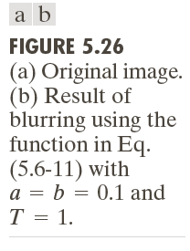

Slide 86
Inverse Filtering
Direct inverse filtering
Limiting the analysis to frequencies near the origin

Slide 88
Minimum Mean Square Error (Wiener) Filtering
Minimize
Terms
= degradation function
= complex conjugate of
=

Slide 89
= power spectrum of the noise
= power spectrum of the undegraded image

Slide 90
Wiener filter

Slide 91
Signal-to-noise ratio

Slide 92
Mean square error

Slide 93
White noise

Slide 95
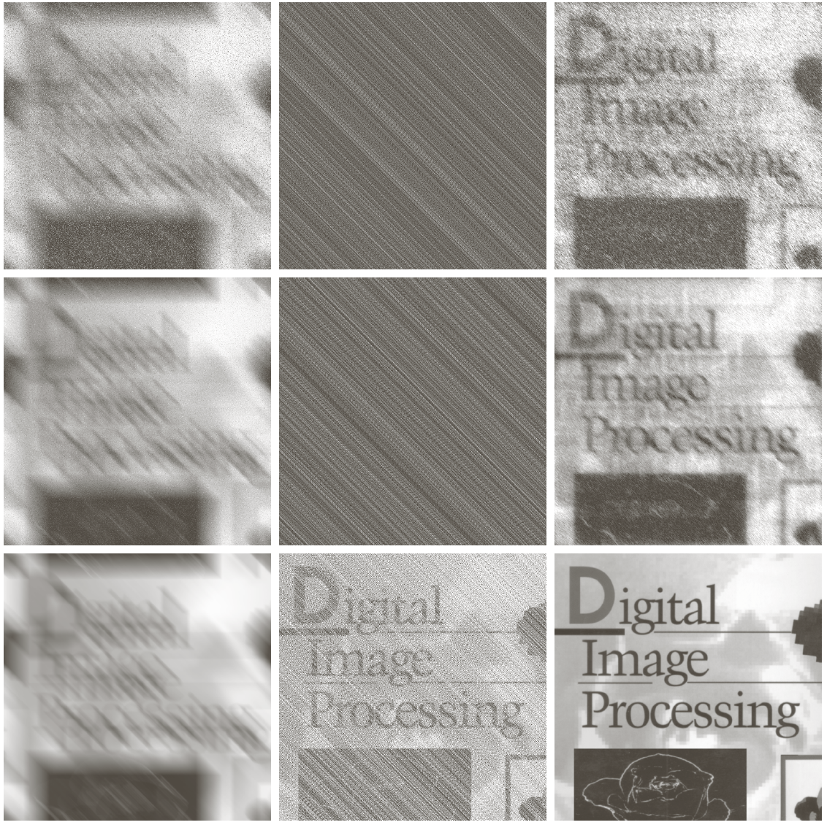

Slide 96
Constrained Least Squares Filtering
Vector-matrix form
, , :
:

Slide 97
Minimize
Subject to

Slide 98
The solution
Where is the Fourier transform of the function

Slide 100
Computing by iteration
Adjust so that

Slide 101
Computation

Slide 102
Algorithm
1: Specify an initial value of
2: Compute
3: Stop if is satisfied; otherwise return to Step 2 after increasing if or
decreasing if .

Slide 104
Geometric Mean FIlter

